Slide 1

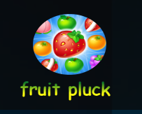

Fruit Pluck Game
Lokesh Reddy Thatiparthi

Slide 2



Agenda
Introduction
Flow
Modules
Demo
Challenges Faced
Future Enhancements

Slide 3
Introduction
Here I designed the game known as ‘Fruit Pluck Game’ using React for frontend, Spring for Backend and Postgresql for Database . Here the concept of game is, multiple fruits would be falling down with certain speed and certain points are associated with each fruit. There would be a basket which we use to collect them.
By the time the fruit falls down from the canvas(game) region, we need to catch those using mouse pluck/clicking towards that fruit, so that the basket would be moving towards it to collect it.
User score would be calculated according to the fruits and no of fruits he can collect with in given limited time. Maximum score would be displayed at bottom of all his attempted scores.

Slide 4
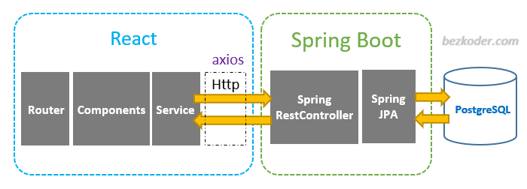
Introduction

Slide 5

Flow
Home Page
Register
Login → (Forgot Password)
Start Game
Profile → Upgrade, Change Password
Logout

Slide 6

Modules : Home Page, Register and Login
In Home Page, we have the logo, title and navbar which consists of Login, Register as the main components before logging in.
If we register with successful validations of fields, then our data would be stored in database by using spring API call. It would check if user existed with same username and email previously and do not allow them again.
When we are logging in, it will check every field validations and then after successful credentials entered then it would generate JWT Token in response for us by Spring and we store that in our Local Storage to use it for authentication of further end points. It redirects to start-game page.
The data in the local storage persists over browser sessions, which means that even closing and opening the browser keeps this data alive.

Slide 7

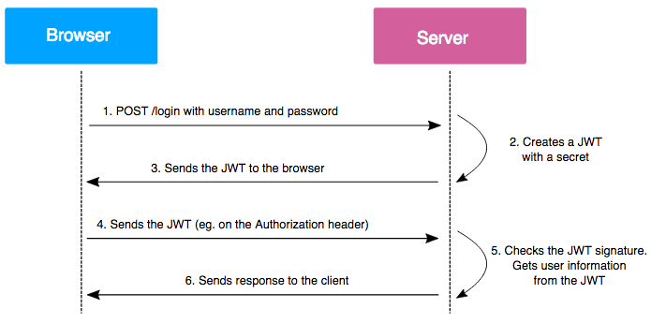
Work Flow

Slide 8

Modules : Game Play and User Page
Whenever we login successfully, we get options of Profile, Start Game and Logout in the header(navbar).
Here In game page, when we click on ‘Click to play’ button our game starts with having timer on top right corner with 30seconds and on top left corner we have score counting down.
Fruits would be start falling as soon as the game starts and our basket would be in center of canvas and we need to use our mouse to pluck or click towards fruits which are moving downwards, so that our basket can move towards the fruit and collect them. It will move in all directions where we pluck/click using mouse.

Slide 9

Modules : Game Play and User Page
Whenever we collect the fruit, the score would be increased, As game ends after 30seconds our game stops and scorecard would be updated in Profile page from our database and calculate the maximum score among all scores.
We can start the game again by ‘Play Again’ button.
In User/Profile page we have the details of the user from database and his scores of all the attempts and maximum score of all those attempts would be displayed.
In User/Profile page we have menu with two options : Change Password and Upgrade.

Slide 10

Modules : Change Password, Upgrade, Logout
When we click on change password we would be redirecting to change password page, where we can create our new password, Here we use put call to update the user details with new password. As soon as password changed successfully, the user gets logged out and navigated to homepage.
In upgrade we gave user an option to be a premium user by selecting our plan and buying it, for that we generated QR code which acts as dummy payment gateway. After few seconds it would be expired as per security concerns.
The option of logout would be on top right in the navbar, where whenever user clicks on logout, then user would be removed from our local storage and navigated to home page to re-login.

Slide 11
Demo
Let’s go through the project !

Slide 12

Challenges
Authentication – solved by JWT Tokenization
Game region for graphics – solved by canvas tag
Adding styling for parents(body) – solved by Helmet tag
Maintaining timer – solved by setTimeout( )
Drawing 2d figures – solved by canvas.getContext(‘2d’)
Used React validation, React qr-code dependencies

Slide 13

Future Enhancements
To implement Admin access, so that admin can able to view all the users scores, their number of attempts and their maximum score.
To implement real payment gateway, so that premium users would get some extra features that we are offering.
To implement level wise gaming which makes users more interested to play the game.
To implement multi player feature so that people can place betting on every turn they play to challenge opponent.

Slide 14
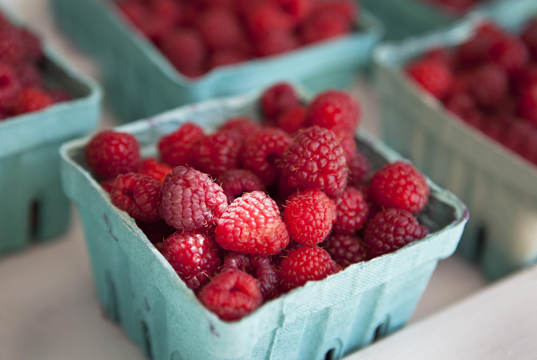
Thank You
Lokesh Reddy Thatiparthi
reddylokesh448@gmail.com

